Slide 1

C Developer
Conditional and Iterative Statements

Slide 2

Course Objectives
Manage conditions
Handle loops

Slide 3

Course Plan
1. Conditional Statements
2. Iterative Statements

Slide 4

1. Conditional Statements

Slide 5

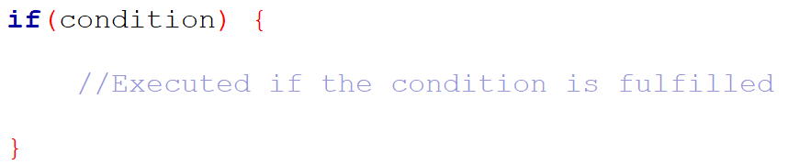
1. Conditional Statements
if
To make a choice, use if statement:
– One or more conditions
– Create instruction blocks
– One or more instruction blocks
Syntax:

Slide 6
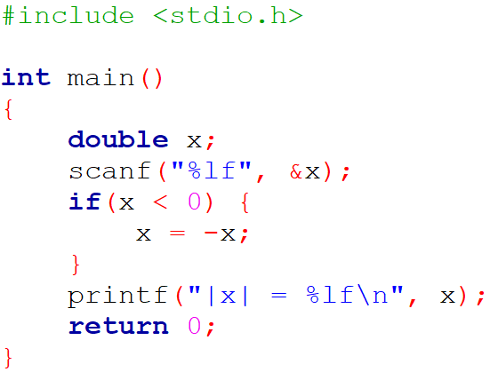

1. Conditional Statements
if

Slide 7
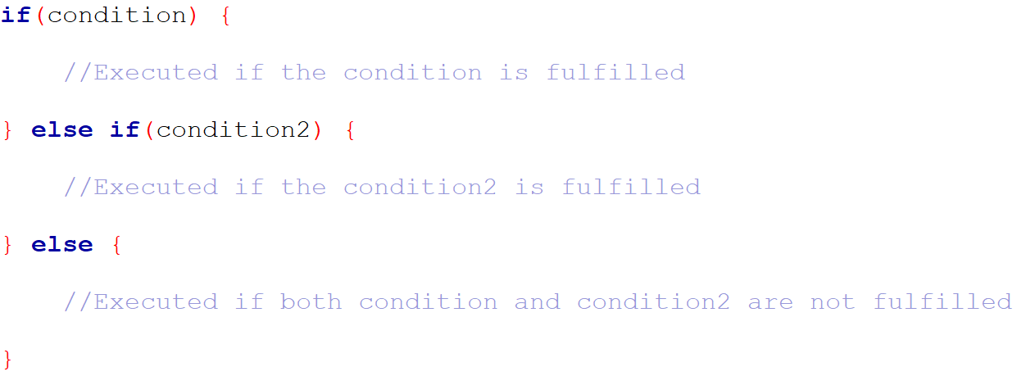
1. Conditional Statements
if … else
Syntax:

Slide 8
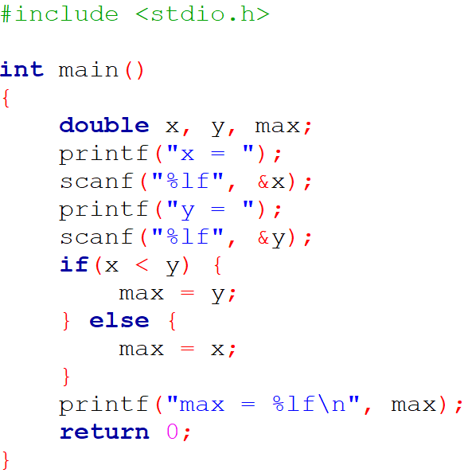
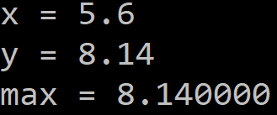
1. Conditional Statements
if … else

Slide 9
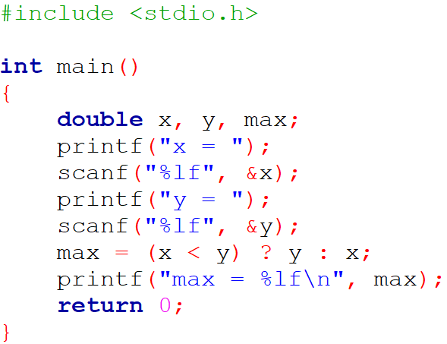
1. Conditional Statements
if … else
… or use the conditional operator here!

Slide 10
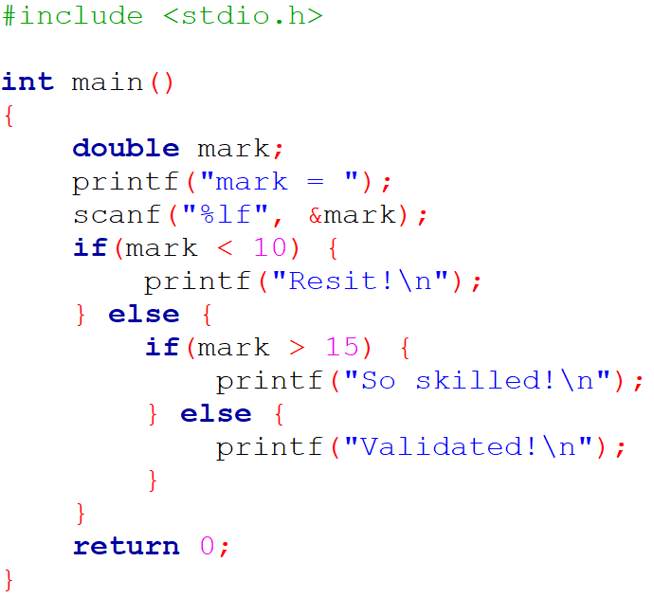

1. Conditional Statements
Nested if … else

Slide 11
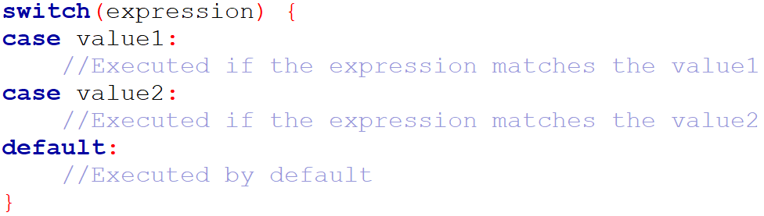
1. Conditional Statements
switch
Can be used for multiple nestings
Syntax:

Slide 12
1. Conditional Statements
switch
When the value of the expression matches one of the case values, the program executes the instructions of this case, but also all those that follow
If you want to perform only the instructions of the concerned case, you must add the break keyword

Slide 13
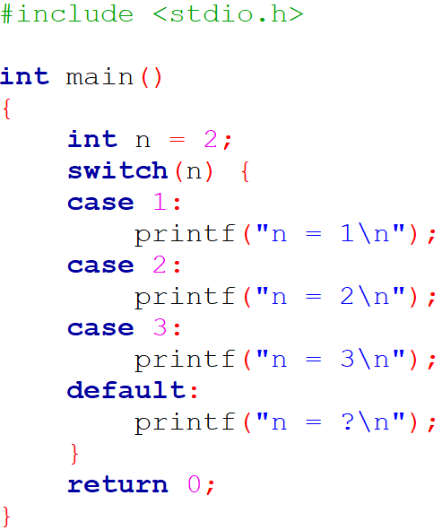
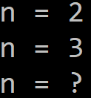
1. Conditional Statements
switch

Slide 14
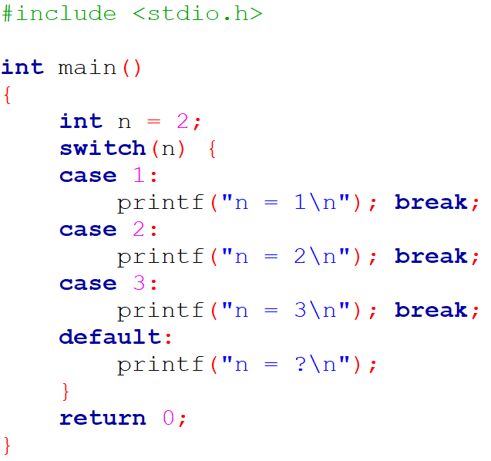

1. Conditional Statements
switch

Slide 15

1. Conditional Statements
Exercise
Ask an integer to the user
Display the month name according to the input number
Manage wrong inputs

Slide 16

1. Conditional Statements
Questions

Slide 17

2. Iterative Statements

Slide 18
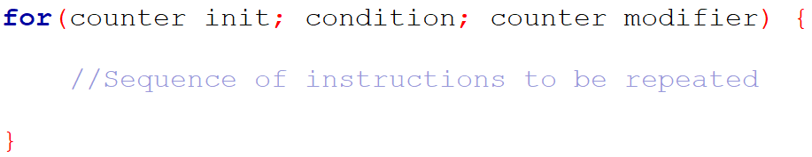
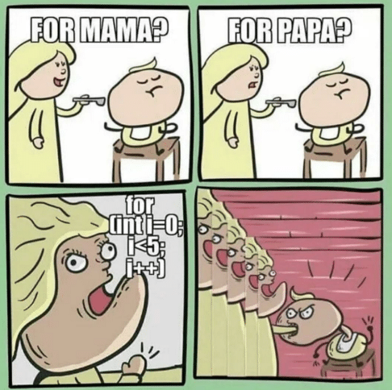
2. Iterative Statements
for
Syntax:

Slide 19
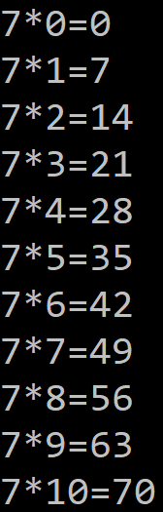
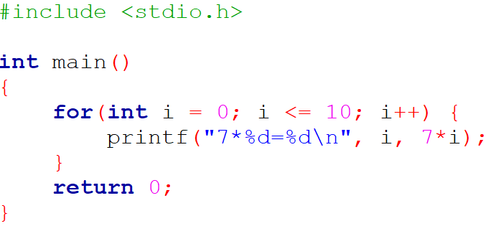
2. Iterative Statements
for

Slide 20
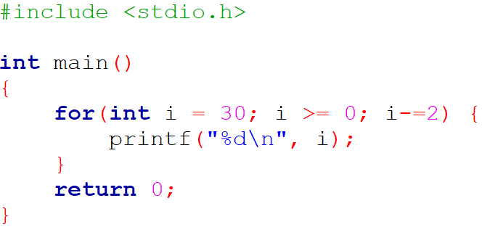
2. Iterative Statements
for

Slide 21
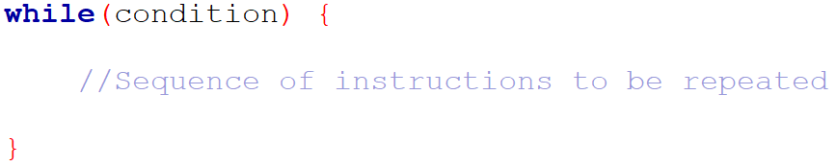
2. Iterative Statements
while
Syntax:
As long as the condition is verified, it allows the repetition of the instructions
Do not forget to modify the value of the expression in the instructions to be repeated, otherwise you will have an infinite number of iterations

Slide 22
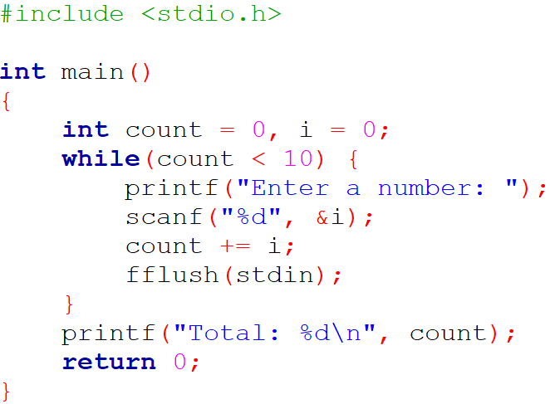
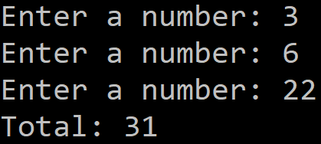
2. Iterative Statements
while

Slide 23
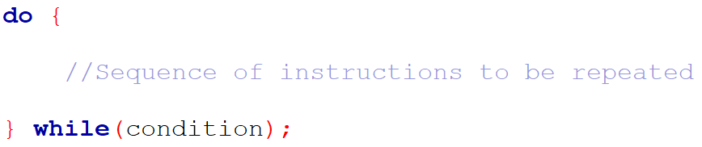
2. Iterative Statements
do … while
Syntax:
In the while structure the condition is evaluated before the iteration and in the do ... while structure it is evaluated after; so, we always have at least one iteration with the do ... while structure

Slide 24
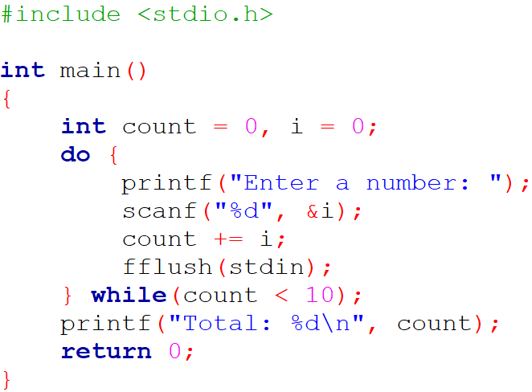
2. Iterative Statements
do … while

Slide 25




2. Iterative Statements
do … while

Slide 26
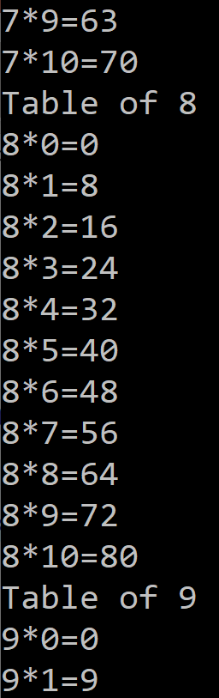
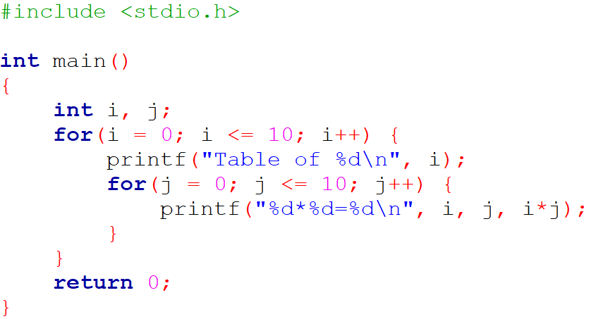
2. Iterative Statements
Nested loops

Slide 27
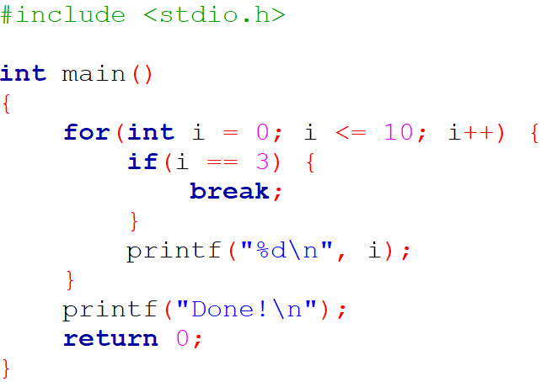
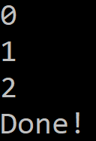
2. Iterative Statements
break and continue
Use the break keyword to exit a loop and cause the early termination of its instructions

Slide 28
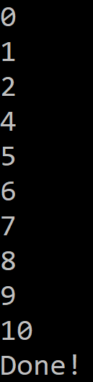
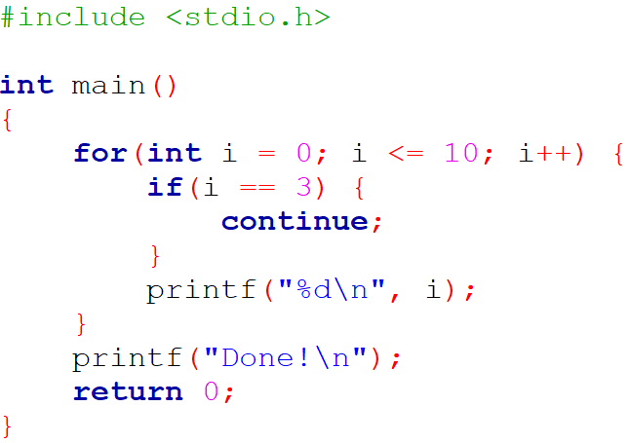
2. Iterative Statements
break and continue
Use the continue keyword to cause a jump to the next iteration of the loop

Slide 29

2. Iterative Statements
Bonus: emptying the input buffer
Remember the following line:
The scanf function works with a buffer: the entered characters are first stored in a memory area, and are available for the scanf function only after pressing the “Enter” key
The function leaves in the buffer the "Enter" character necessary for the validation of the input, and the next input will start with this character

Slide 30
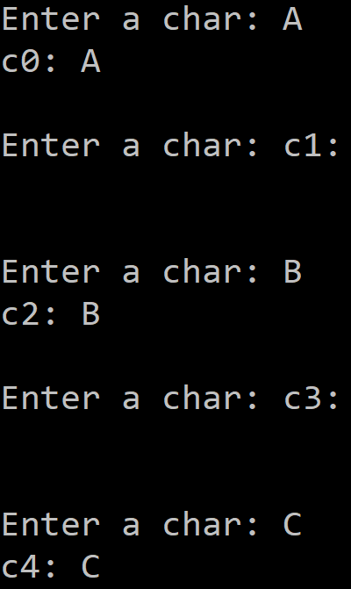
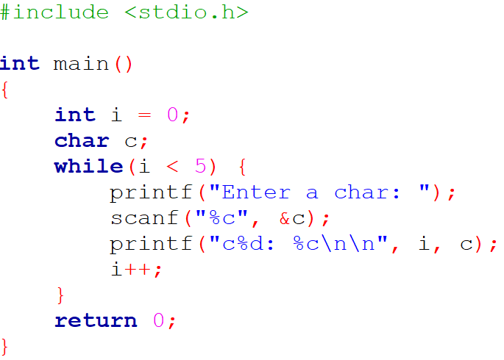
2. Iterative Statements
Bonus: emptying the input buffer

Slide 31
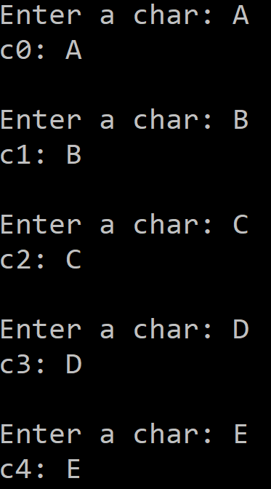
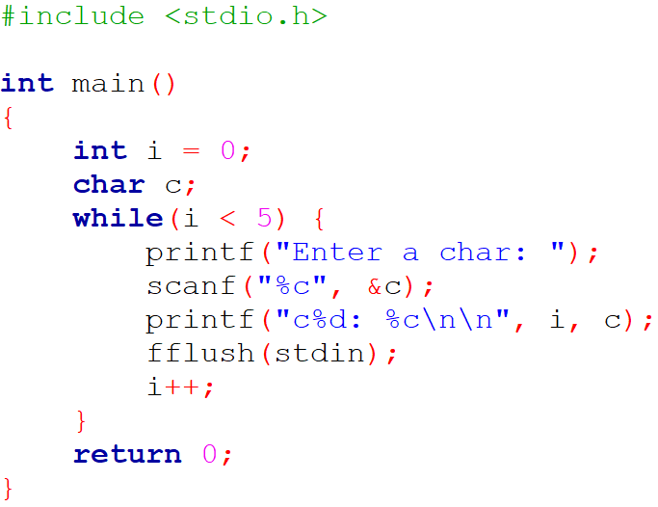
2. Iterative Statements
Bonus: emptying the input buffer
You must empty the input buffer!
or

Slide 32
2. Iterative Statements
Exercise
Ask the user to enter several numbers
Stop the input process when the user enters “0”
Display the sum of the numbers

Slide 33
2. Iterative Statements
Questions

Slide 34

C Developer
Conditional and Iterative Statements
Thank you for your attention

